Slide 1

EMBARGOED for 5:30 pm ET 11-16-19
Early Surgery versus Conventional Management for Asymptomatic Severe Aortic Stenosis
Duk-Hyun Kang MD PhD
on behalf of the RECOVERY Investigators
Asan Medical Center
Seoul, Korea
AHA 2019 Late Breaking Trial
Notes:
Thank you, Dr. Kim. Good evening, ladies and gentlemen. I am very honored to present our study at this late breaking trial session, and I’d like to talk about early surgery versus conventional management for asymptomatic severe AS. I don’t have any disclosure relevant to this study.

Slide 2
Introduction
Although aortic valve replacement (AVR) is the only effective therapy for symptomatic severe aortic stenosis (AS), optimal timing for AVR in asymptomatic severe AS remains controversial
In asymptomatic patients, the potential benefit of preventing sudden death may not be greater than the risk of AVR
Watchful observation is recommended for the majority of asymptomatic patients, with AVR planned once symptoms develop
Recent advances in surgery may change the risk-to-benefit ratio
Risk
Benefit
Risk
Benefit
Notes:
Although aortic valve replacement (AVR) is the only effective therapy for symptomatic severe aortic stenosis (AS), there has been no proof that AVR improves outcome in asymptomatic severe AS and optimal timing of intervention for these patients remains controversial.
Based on consensus opinion that the potential benefit of AVR to prevent sudden death (occurring about 1% per year) in asymptomatic patients may not be greater than the risk of AVR such as operative mortality and aortic valve (AV) prosthesis-related mortality, watchful observation is recommended for the vast majority of asymptomatic patients with severe AS, with AVR planned once symptoms develop.
However, recent advances in surgery may change the risk-to-benefit ratio of AVR, especially in patients at low surgical risk

Slide 3
Method: Study Design and Patients
RECOVERY A prospective, multicenter, open-label, randomized trial to compare long-term clinical outcomes of early surgical AVR vs. conservative management in asymptomatic pts with very severe AS
Inclusion | Exclusion
Age 20-80 years | Presence of symptoms (exertional dyspnea, syncope, or angina)
Very severe AS (defined as AVA≤0.75cm² with peak aortic jet velocity ≥4.5m/s or mean trans-aortic gradient ≥50mmHg) | LV ejection fraction <50% Significant aortic regurgitation Significant mitral valve disease
Candidates for early surgery | Previous cardiac surgery
Informed consent | Positive exercise test
Clinicaltrials.gov NCT01161732
Notes:
The current conservative strategy has never been compared with early AVR in a randomized trial, and we conducted the first, randomized trial at 4 medical centers in Korea to compare long-term outcomes in asymptomatic patients with very severe AS
We screened consecutive patients aged 20 to 80 years who presented with very severe aortic stenosis. According to the 1998 ACC/AHA guidelines and a traditional definition of severe AS, we defined very severe AS as an aortic valve area smaller than 0.75 cm2 with either a peak aortic jet velocity greater than 4.5 m/s or a mean transaortic gradient greater than 50 mmHg.
In accordance with current guidelines, patients were excluded if they had symptoms, a left ventricular ejection fraction less than 50%, significant aortic regurgitation, significant mitral valve disease, or previous cardiac surgery. Exercise testing was selectively performed to evaluate patients with non-specific symptoms, and those with a positive exercise test were excluded.
We also excluded patients who were not candidates for early surgery on the basis of age over 80 years or poor medical condition, such as the presence of malignancy.

Slide 4
Method: Study Procedures
Patients were randomly assigned on a 1:1 basis to early surgery or conventional treatment using a Web-based interactive response system
In the early surgery group, AVR should be performed within 2 months of randomization
Patients in the conventional treatment group were treated according to the current guidelines and referred for AVR if they became symptomatic, LV EF < 0.50 or an increase in peak aortic velocity > 0.5 m/s per year
Notes:
Patients were randomly assigned on a 1:1 basis to early surgery or conventional treatment
The protocol specified that patients assigned to the early surgery group should undergo AVR within 2 months of randomization.
Patients assigned to the conventional treatment group were treated according to the current guidelines and they were referred for surgery if they became symptomatic during follow-up, if the left ventricular ejection fraction decreased to less than 50%, or if the peak aortic jet velocity increased each year by greater than 0.5 m/s on follow-up echocardiography.

Slide 5
Method: Endpoints
Hypothesis Early surgery would reduce the risk of cardiovascular
mortality as compared with conservative management
End point | Sample size
Primary end point* - Operative mortality - Cardiovascular death Secondary end point* - All-cause death - Repeat aortic valve surgery - Clinical thromboembolic event - Hospitalization for CHF | Assumptions Event rate of 2% in early surgery vs. 16% in conventional group during minimum follow-up of 4 years (Kang DH et al. Circulation 2010) 80% Power at 2-sided significance level of 0.05 Estimated sample N=144
*occurred during 4-year follow-up period after enrollment of the last patient
Notes:
The primary end point was a composite of operative mortality or cardiovascular death during the entire follow-up period continuing until 4-years after the last patient was enrolled
Secondary end points included all-cause death, repeat aortic valve surgery, clinical thromboembolic event and hospitalization for heart failure during follow-up
Based on our previous observational study, we assumed that the rate of the primary outcome would be 2% in the early surgery group and 16% in the conventional management group during a minimum follow-up of 4 years and we estimated that a sample size of 144 patients would provide the trial with 80% power to detect a significant difference in the primary end point,
We also assumed that an enrollment period of 2 years would be needed to complete enrollment and that the rate of loss to follow-up would be 10%.

Slide 6
Results: Study Flow
Very severe AS
(N=1031, July 2010 – April 2015)
1:1 Randomization in 145 patients
Asymptomatic (N=273)
Symptomatic (N=758)
Early surgery
(N=73)
Conventional Tx
(N=72)
Exclusion (N=128)
LVEF <50% (11)
Malignancy (21)
Mitral valve disease (14)
Severe AR (16)
Age >80 years (39)
Positive exercise test (3)
Decline to participate (24)
ITT analysis
(N=73)
ITT analysis
(N=72)
Underwent randomization
(N=145)
Cross-over (4) to Conventional Tx
Early surgery (2)
TAVR (1)
Per-protocol
(N=69)
Per-protocol
(N=69)
Clinicaltrials.gov NCT01161732
Notes:
We began our trial in 2010 and it took 5 years to complete enrollment. Of the 1031 patients with very severe aortic stenosis, 758 patients (74%) with symptoms were excluded; 273 asymptomatic patients were assessed for eligibility, 128 of whom were excluded.
Of the 145 patients who underwent randomization, 73 were assigned to the early-surgery group and 72 to the conventional-treatment group; all these patients were included in the intention-to-treat analysis.
After randomization, 4 patients assigned to early surgery crossed over to conventional management; among these 4 patients, surgical aortic-valve replacement was performed later after development of symptoms in 3 and not attempted in 1. In the conventional-treatment group, 2 patients crossed-over to early surgery and 1 underwent TAVR during follow-up and they were excluded from the per-protocol analysis.

Slide 7
Results: Baseline Characteristics
Patient characteristics
 | Conventional (n=72) | Early AVR (n=73)
Age (years) | 63±11 | 65±8
Male | 34 (47%) | 37 (51%)
Diabetes | 7 (10%) | 13 (18%)
Hypertension | 39 (54%) | 40 (55%)
Coronary disease | 1 (2%) | 5 (7%)
Previous stroke | 3 (4%) | 3 (4%)
Atrial fibrillation | 6 (8%) | 3 (4%)
Creatinine (mg/dl) | 0.8±0.2 | 0.8±0.2
EuroSCORE II (%) | 0.9±0.4 | 0.9±0.3
Echocardiographic Findings
 | Conventional (n=72) | Early AVR (n=73)
Peak AV jet velocity (m/s) | 5.0±0.4 | 5.1±0.5
Mean AV PG (mmHg) | 63±12 | 64±14
Aortic valve area (cm²) | 0.64±0.09 | 0.63±0.09
LV mass index (g/m²) | 134±31 | 136±38
LV ejection fraction (%) | 65±4 | 65±5
Cause of AS
Bicuspid | 39 (54%) | 49 (67%)
Degenerative | 26 (36%) | 22 (30%)
Rheumatic | 7 (10%) | 2 (3%)
Notes:
The treatment groups were generally well balanced with regard to baseline clinical characteristics. The mean age was 64±9 years and 49% were men. Mean EuroSCORE II was 0.9. The peak aortic jet velocity averaged 5.1±0.5 m/sec, and the mean aortic-valve area was 0.63±0.09 cm2. The most common cause of aortic stenosis was a bicuspid aortic valve.

Slide 8
Results: AVR Procedures
 | Conventional Treatment (n=72) | Early Surgery (n=73)
Performance of AVR | 53 (74%) | 72 (99%)
Early surgery | 2 (4%) | 69 (96%)
Urgent surgery | 9 (17%) | 0 (0%)
Mechanical prosthesis | 21 (40%) | 36 (50%)
CABG | 1 (2%) | 5 (7%)
Replacement of aorta | 8 (15%) | 7 (10%)
Operative mortality | 0 (0%) | 0 (0%)
Stroke | 0 (0%) | 1 (1%)
Myocardial infarction | 1 (2%) | 0 (0%)
Reoperation | 0 (0%) | 0 (0%)
Notes:
In the early surgery group, surgical AVR was successfully performed on all of 72 patients in whom AVR was attempted. All the patients except crossovers underwent surgery within 2 months after randomization; the median time between randomization and surgery was 23 days. There was no operative mortality in the early surgery group.
In the conservative management group, 53 (73.6%) patients underwent surgical aortic-valve replacement (52 patients) or transcatheter aortic-valve replacement (1 patient), mainly due to development of symptoms (43 patients) during follow-up. The median time from randomization to aortic-valve replacement was 700 days and none of the patients who later underwent aortic-valve replacement died during surgery;

Slide 9
Results: End Points
 | Conventional | Early surgery | Hazard ratio | P value
Primary end point (Operative or CV death) | 11 (15.3%) | 1 (1.4%) | 0.09 (0.01-0.67) | 0.003
Secondary end point
All-cause mortality | 15 (20.8%) | 5 (6.8%) | 0.33 (0.12-0.90) | 0.030
Thromboembolic events - Stroke - Myocardial infarction | 4 (5.6%) 3 1 | 1 (1.4%) 1 0 | 0.30 (0.04-2.31) | 0.25
Repeat AV surgery | 2 (2.8%) | 0 (0%) | 0.19 (0.10-8.00) | 0.39
CHF hospitalization | 8 (11.1%) | 0 (0%) | 0.05 (0.00-1.05) | 0.054
Notes:
This is the final results of our trial. The median follow-up was 6.2 years (interquartile range, 5.0 to 7.4) in the early-surgery group and 6.1 years (interquartile range, 4.5 to 7.3) in the conservative-management group, and no patients were lost to follow-up.
In an intention-to-treat analysis, 1 patient in the early surgery group and 11 patients in the conventional management group died from cardiovascular causes (hazard ratio in the early-surgery group, 0.09; 95% confidence interval [CI], 0.01 to 0.67) (Table 2). The number needed to prevent one cardiovascular death within 4 years was 20 patients.
A total of 5 deaths (6.8%) from any cause occurred in the early-surgery group and 15 (20.8%) in the conservative-management group (hazard ratio, 0.33; 95% CI, 0.12 to 0.90). The number needed to save one life within 4 years was 16 patients.
The rate of hospitalization for heart failure (0% vs. 11.1%) was lower in the early-surgery group than in the conservative-management group. The cumulative incidence of the composite of any secondary end point or aortic-valve replacement in the conservative-management group was 63% at 4 years and 92% at 8 years.

Slide 10
Results: Primary Analysis
Operative or CV Death
Death from Any Causes
Operative or CV death (%)
Death from Any Cause (%)
P=0.003 (log-rank)
Conventional
Early surgery
P=0.018 (log-rank)
Conventional
Early surgery
31.8%
25.5%
9.7%
10.2%
Years since randomization
Years since randomization
5.7%
4.1%
1.4%
1.4%
Number at risk
Number at risk
Early Surgery
73 73 70 38 13
72 68 65 36 12
Early Surgery
73 73 70 38 13
72 68 65 36 12
Conventional
Conventional
Notes:
The cumulative incidence of the primary end point (operative or cardiovascular mortalities) was 1.4% at 4 and 8 years in the early surgery group as compared with 5.7% at 4 years and 25.5% at 8 years in the conventional management group (P=0.003)
The cumulative incidence of death from any cause was also lower in the early surgery group than in the conventional management group (10.2% vs. 31.8% at 8 years).

Slide 11
Results: Secondary Per-Protocol Analysis
Operative or CV Death
Death from Any Causes
Operative or CV death (%)
Death from Any Cause (%)
p=0.003 (log-rank)
Conventional
Early surgery
p=0.008 (log-rank)
Conventional
Early surgery
32.7%
26.2%
10.1%
Years since randomization
Years since randomization
5.9%
6.6%
4.3%
1.5%
1.5%
Number at risk
Number at risk
Early Surgery
69 69 67 38 14
69 66 63 34 13
Early Surgery
69 69 67 38 14
69 66 63 34 13
Conventional
Conventional
Notes:
The results of the per-protocol analyses were consistent with those of the primary intention-to-treat analyses.

Slide 12
Limitations
Patients with very severe AS (aortic velocity > 4.5 m/s)
Cross-over in 4%: Similar results in per-protocol analysis
Selective performance of exercise test
Younger patients with low operative risk and higher incidence of bicuspid AV: Our results cannot be directly applied to early TAVR for asymptomatic severe AS
Notes:
Our study has several limitations. First, this trial enrolled patients with very severe aortic stenosis, and the benefit of early surgery may be relatively smaller in asymptomatic patients with less severe aortic stenosis.
Cross-over occurred in 4%. The small number of study patients and primary end point events is also a limitation. However, a larger number of patients than the calculated sample size could not be enrolled for ethical and logistical reasons.
Exercise testing is reasonable to confirm the absence of symptoms, but it was performed only selectively in this study.
Finally, this trial included relatively young patients with high incidences of bicuspid aortic-valve, few comorbidities and low operative risk. Thus, our study population is quite different from the populations enrolled in the TAVR trials and the results of our study cannot be directly applied to early TAVR for asymptomatic severe aortic stenosis.

Slide 13

Conclusions
Early surgical AVR (vs. conservative management) significantly reduced the rates of operative or cardiovascular death, and death from any cause in asymptomatic patients with very severe AS
The RECOVERY trial provides the evidence for early preemptive AVR
AHA 2019 Late Breaking Trial
Notes:
In this randomized trial, early surgical aortic-valve replacement, as compared with conservative management, significantly reduced the rates of cardiovascular death and death from any cause among asymptomatic patients with very severe aortic stenosis.
Ladies and gentlemen, in conclusion, the RECOVERY trial provides the evidence to support early preemptive aortic-valve replacement for asymptomatic severe aortic stenosis.

Slide 14
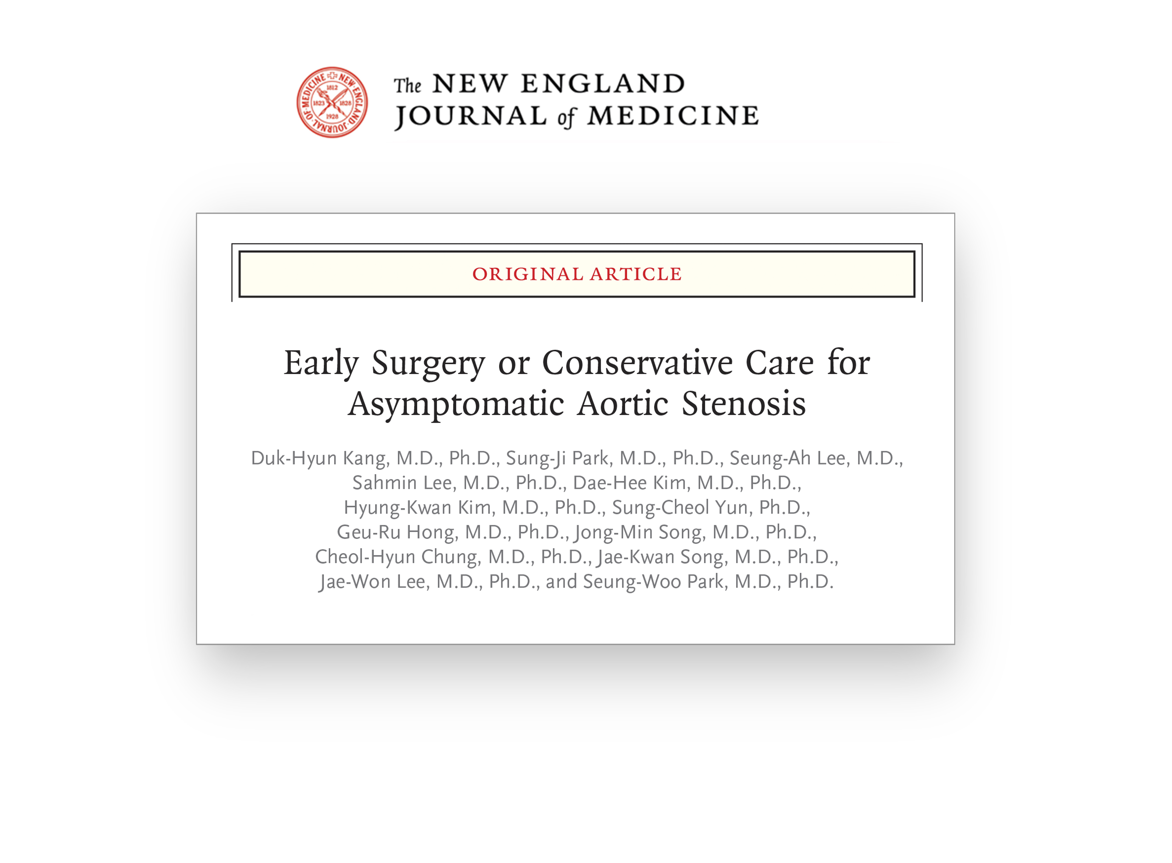
Notes:
Our study was simultaneously published in the New England Journal of Medicine, this evening. Thank you for attention.

